Slide 1


SALES DATASET ANALYSIS – ADVANCED EXCEL PROJECT
BY:
THARANI VENKATESH
DA/DS
FEB 2025 BATCH

Slide 2
Project Overview & Objectives
Project Objective
To conduct a comprehensive analysis of sales data in order to uncover trends, evaluate sales performance, and generate actionable insights for informed business decision-making.
Goals
Examine sales trends across different time periods.
Pinpoint top-performing products and effective sales channels.
Assess the influence of returns and discounts on revenue.
Design an interactive and insightful dashboard showcasing key metrics for quick access and analysis.

Slide 3
Data Description and Preparation
Dataset Overview
This dataset contains approximately [your actual row count] rows and [your actual column count] columns.
Key columns include:
Order ID
Sale ID
Product Type
Order Date
Sale Amount ,etc..
Data Cleaning Process
Duplicates were identified and removed to ensure data consistency.
Standardized formatting applied to the entire dataset:
Proper Date formats (e.g., DD-MM-YYYY for Order Date and Ship Date).
Corrected erroneous sales entries and flagged negative values using conditional formulas (e.g., IFERROR).

Slide 4
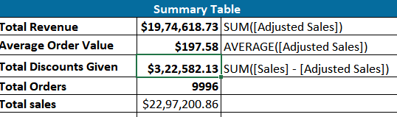
Key Metrics Calculation and Data Analysis
Important Calculations:
1. Total sales :
$1974618.73
2. Average sales per order
$197.58
3. Discount rates:
$322582.13
Screenshot:

Slide 5
Pivot Tables and Pivot Charts
Pivot Table Summary
A PivotTable was created using the “Ship Mode” column to analyze sales performance across different sales channels.
The following metrics were calculated for each sales channel:
Total Sales – To understand revenue contribution by channel.
Average Sales – To compare average revenue per transaction.
Total Discounts – To evaluate how discounts vary by channel.
This helped identify which shipping modes (e.g., First Class, Second Class, Standard Class, Same Day) were more profitable or discount-heavy.
Best-Selling Products / Categories
Another PivotTable was used to group data by Product Name and Category.
Fields used:
Quantity – To identify top-selling items based on volume.
Sales – To identify products bringing in the highest revenue.
This analysis helped highlight:
Top-performing products and categories (e.g., Technology, Furniture, Office Supplies).
Sales trends that could inform inventory and marketing strategies.

Slide 6
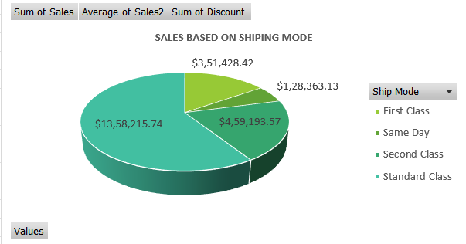
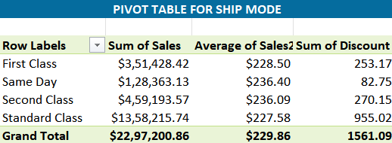
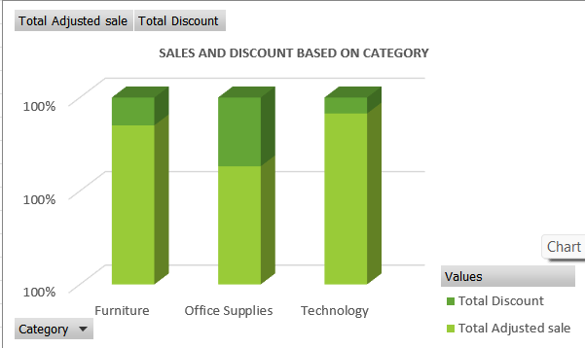
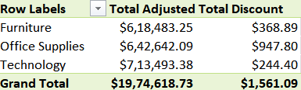
Screenshot

Slide 7
What-If Analysis & Goal Seek
What-If Analysis:
IT helps you explore different business scenarios without changing your actual data.
Goal Seek:
It is used to reverse-calculate a value
instead of guessing hoe to reach a goal, you tell Excel your target value, and it finds the input needed to reach it.
1.Scenario 1: 10% Increase in Sales
Used What-If Analysis to simulate how a 10% increase in sales would impact the total revenue.
The scenario showed a significant boost in revenue, emphasizing the potential of increased unit sales or price optimization.
2.Scenario 2: 5% Decrease in Discount Rate
Simulated the effect of lowering the discount rate by 5%.
Results showed an increase in Adjusted Sales and overall profitability, suggesting discount optimization could boost profit margins.
3.Scenario Manager:
Created and compared multiple sales and discount rate scenarios using Scenario Manager.
Each scenario highlighted how small changes in key variables (sales or discounts) could influence profit or adjusted sales.

Slide 8
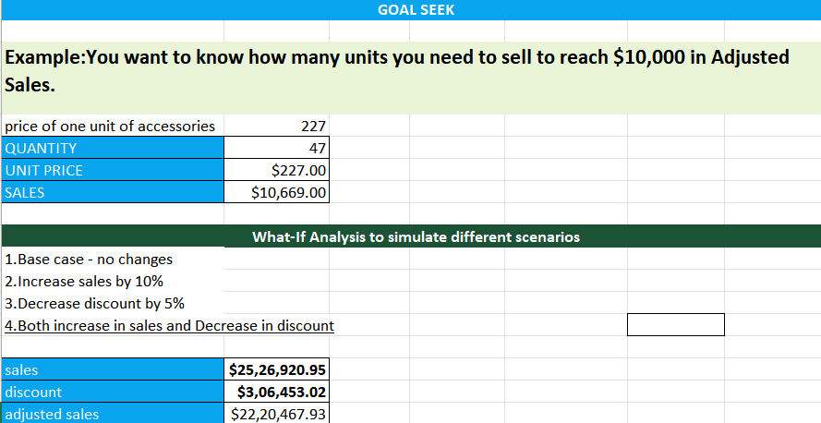
Screenshot

Slide 9
Dashboard Design & Purpose
This interactive Sales Dashboard was created in Excel to visually represent the key metrics from the Super Store dataset.
The dashboard enhances data accessibility and decision-making by providing:
A high-level summary of performance through KPIs.
Visual breakdowns of sales and discounts by category, sub-category, and shipping mode.
Slicers for dynamic filtering based on Category, Sub-Category, Quarter, Order Date, and Ship Mode.
KPIs (Top Row):
Total Sales: $19,74,618.73
Average Order Value: $197.58
Total Discount: $3,22,582.13
Total Orders: 9,994
Visual Elements:
Column Chart showing Adjusted Sales vs Total Discount by Category.
Pie Charts showing:
Consumer Sales Split by Category.
Sales Distribution by Ship Mode.
Bar Chart showing quarterly performance over time.
Line + Column Combo Chart comparing Sales, Adjusted Sales, and Quantity by Ship Mode.
Category/Sub-Category Charts for deep product-level insights.

Slide 10
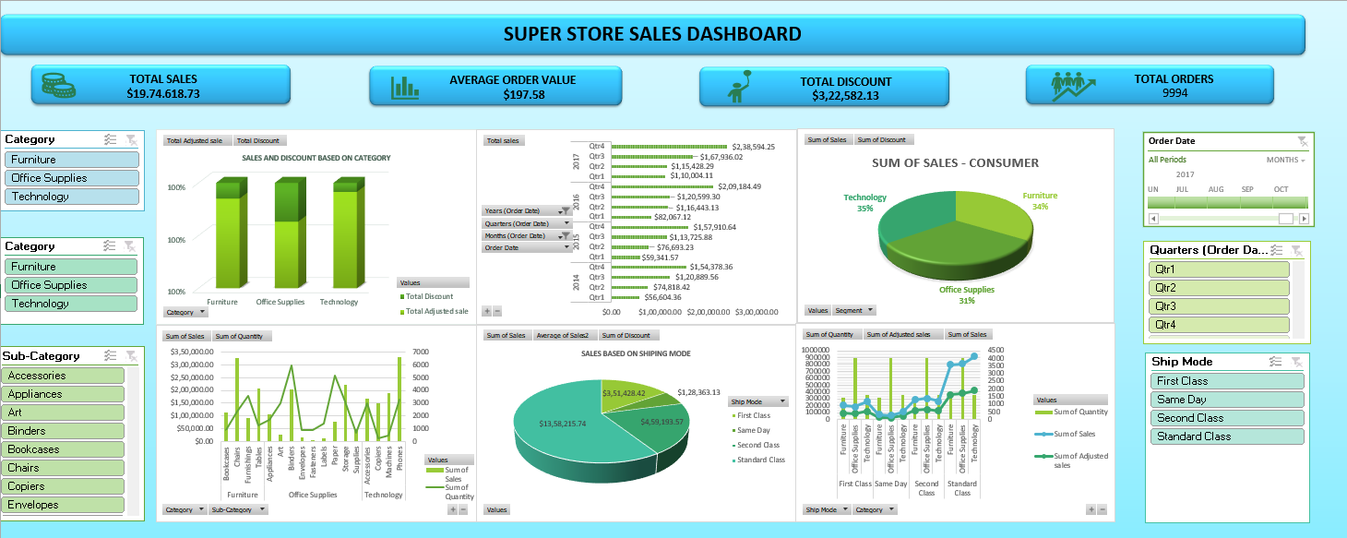
Screenshot

Slide 11
Macros in Excel
A macro in Excel is a set of instructions or commands that can be recorded and played back to automate repetitive tasks. It is like a shortcut that performs a series of actions automatically — just by clicking a button or running the macro.
How It Works:
Excel allows you to record your actions (like formatting cells, entering data, or creating charts).
These recorded steps are saved as VBA code (Visual Basic for Applications).
You can run the macro anytime to repeat the exact same steps — instantly!

Slide 12
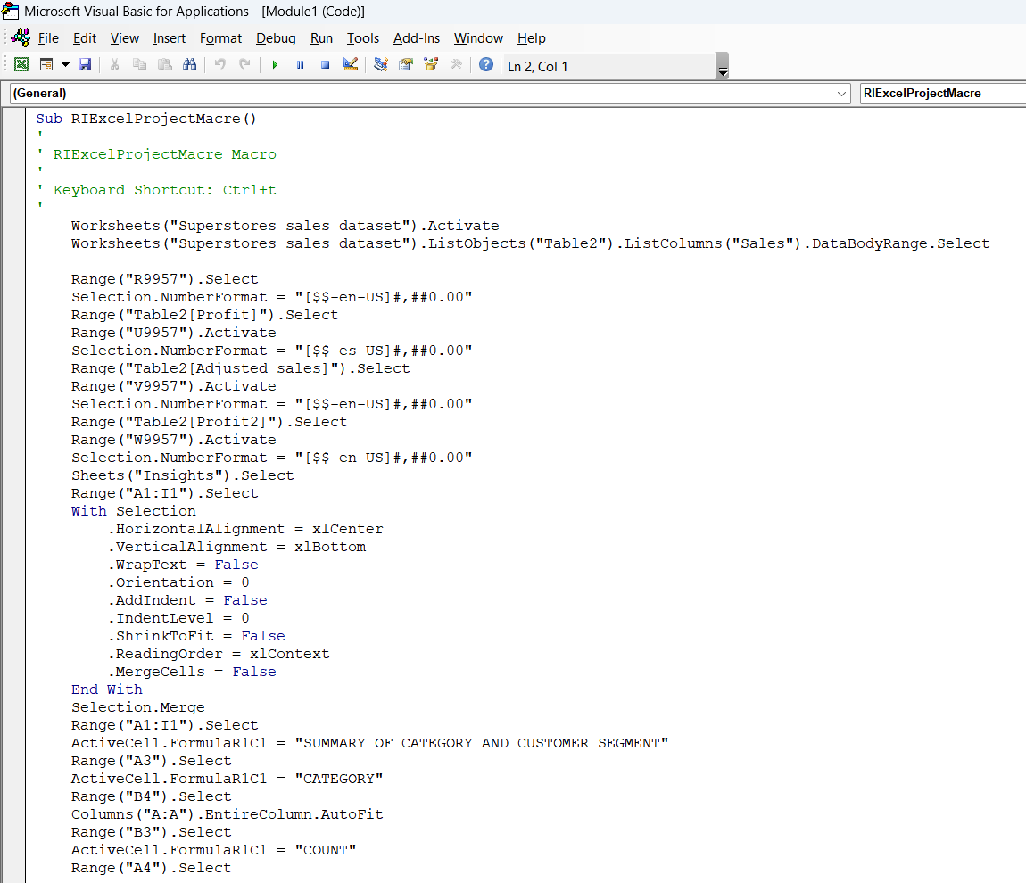
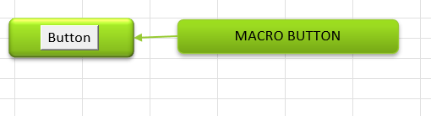
Screenshot
VBA CODE
BUTTON TO RUN VBA CODE

Slide 13
Insights and Recommendations
INSIGHTS:
Shipping Mode Trends:
Standard Class accounts for 59% of total adjusted sales — it's the dominant and most preferred mode.
Same Day shipping has low adoption (6%) and may not justify broad usage.
Product Category Performance:
Technology drives the highest revenue with fewer units — indicating high-value items.
Office Supplies has the highest volume but lower per-unit value.
Furniture underperforms in both sales and quantity.
Discount Impact:
Furniture suffers the most from discounts (16.65% loss).
Technology and Office Supplies show better control of discounting, especially Office Supplies (only 10.62% discount impact).

Slide 14
Insights and Recommendations
RECOMMENDATIONS:
Shipping Optimization:
Focus campaigns and bulk orders on Standard Class.
Limit Same Day to premium products or metro areas.
Encourage First/Second Class with promotional discounts.
Sales Strategy:
Highlight high-margin Technology items with targeted promotions.
Launch bundles/subscription plans for Office Supplies to increase value.
Rebrand and promote Furniture through seasonal campaigns or discounts.
Discount Strategy:
Apply data-driven discounting — avoid excessive offers on strong products.
Reduce high discount losses in Furniture with controlled offers.
Maintain modest, effective discounts in Office Supplies.
Return Management:
Improve product details, delivery care, and packaging — especially for large items — to reduce returns.

Slide 15

THANK YOU

